Slide 1
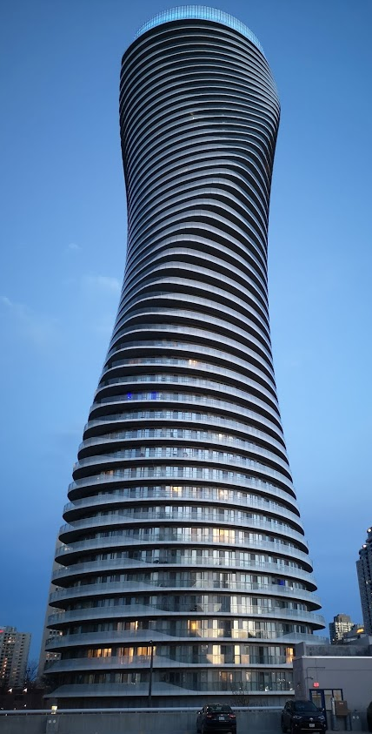
Teranet dataset
EDA results
Prepared by: Stepan Oskin
Notes:
Growth centers
West Don Lands
Liberty village
Riverdale
Outline
Deadline to submit thesis
Month-by-month tuition

Slide 2
Section 1:
Distributions

Slide 3
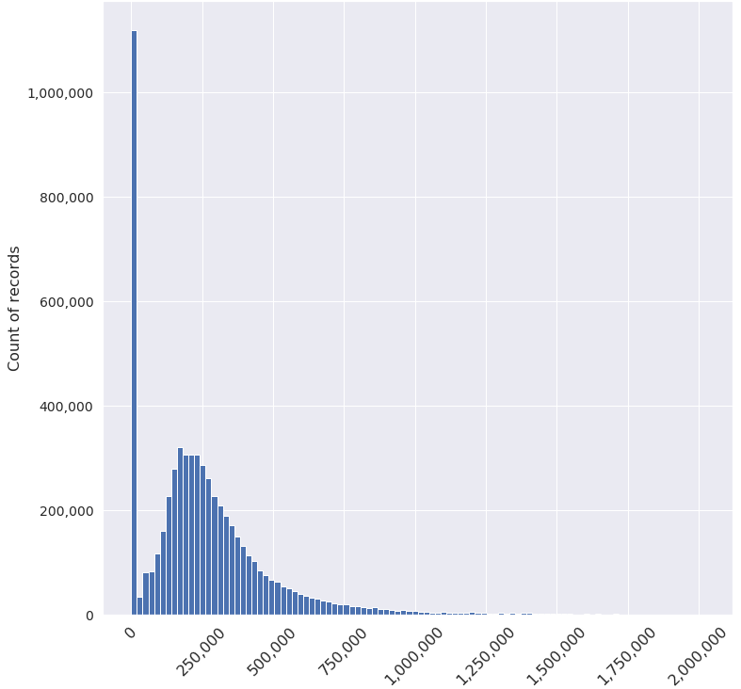
1.1.1: Distribution of price corrected to 2016
No bottom cut-off
Records with consideration amount above 2’000’000 CAD remain in the dataset, but have been excluded from this plot

Slide 4
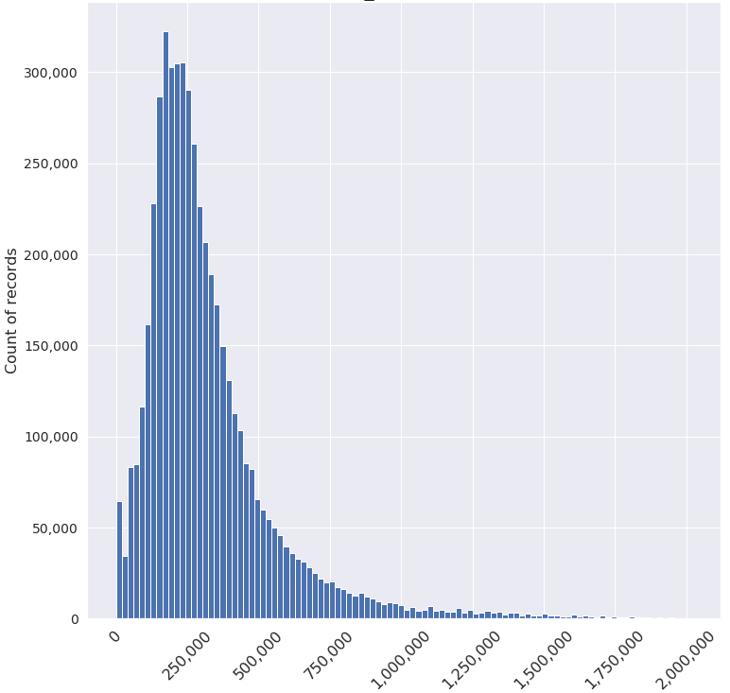
1.1.2: Distribution of price corrected to 2016
Records with consideration amount < 1’000 CAD have been removed
Records with consideration amount above 2’000’000 CAD remain in the dataset, but have been excluded from this plot

Slide 5
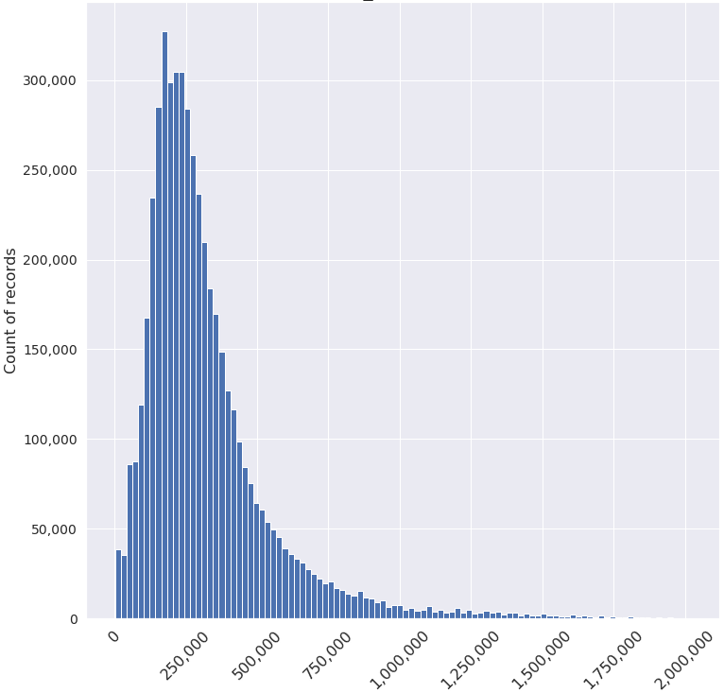
1.1.3: Distribution of price corrected to 2016
Records with consideration amount < 5’000 CAD have been removed
Records with consideration amount above 2’000’000 CAD remain in the dataset, but have been excluded from this plot

Slide 6
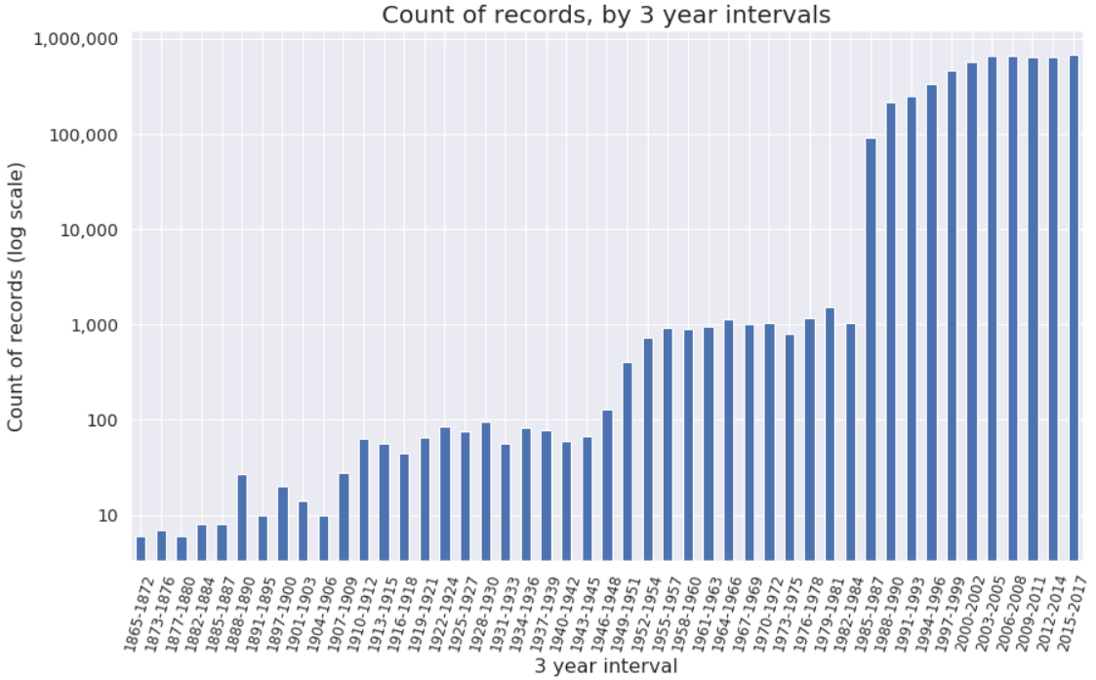
1.2: Distribution of count of records
Dramatic change in the count of records from 1984 to 1985

Slide 7
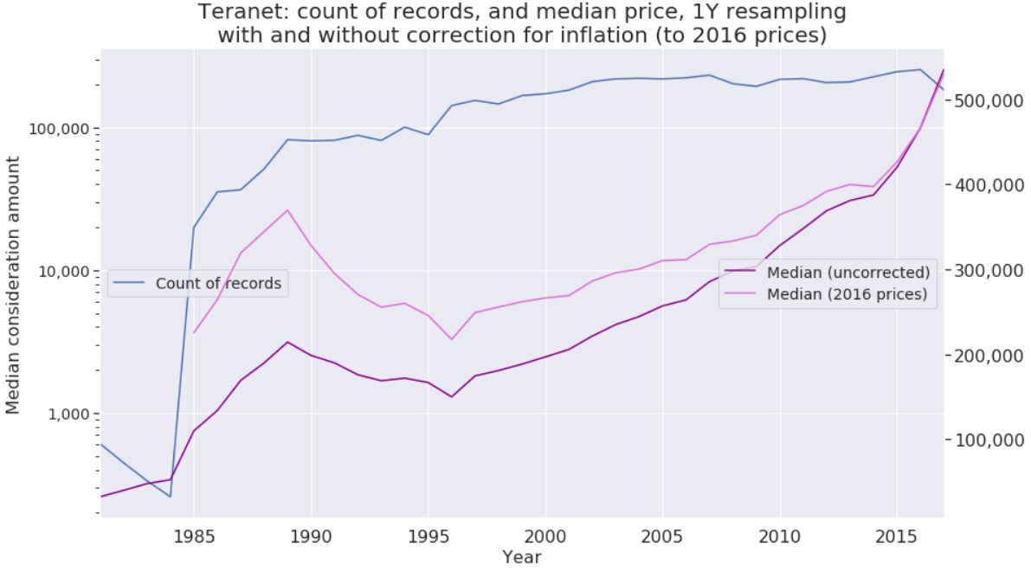
1.3: Median consideration amount
with and without correction for inflation (to 2016 prices)
YEAR | 1985 | 1986 | 1987 | 1988 | 1989 | 1990 | 1991 | 1992 | 1993 | 1994 | 1995 | 1996 | 1997 | 1998 | 1999 | 2000
Percentage change compared to 2016 prices (X) | 104.92 | 97.40 | 88.47 | 81.32 | 72.36 | 65.09 | 55.35 | 53.69 | 51.17 | 51.17 | 47.21 | 45.06 | 42.65 | 41.25 | 38.97 | 35.18
2001 | 2002 | 2003 | 2004 | 2005 | 2006 | 2007 | 2008 | 2009 | 2010 | 2011 | 2012 | 2013 | 2014 | 2015 | 2016 | 2017 | 2018 | 2019
30.80 | 29.23 | 25.95 | 22.84 | 20.77 | 17.90 | 15.37 | 11.87 | 12.16 | 11.10 | 7.76 | 6.17 | 4.96 | 2.54 | 1.49 | 0 | -1.00 | -3.37 | -5.28

Slide 8
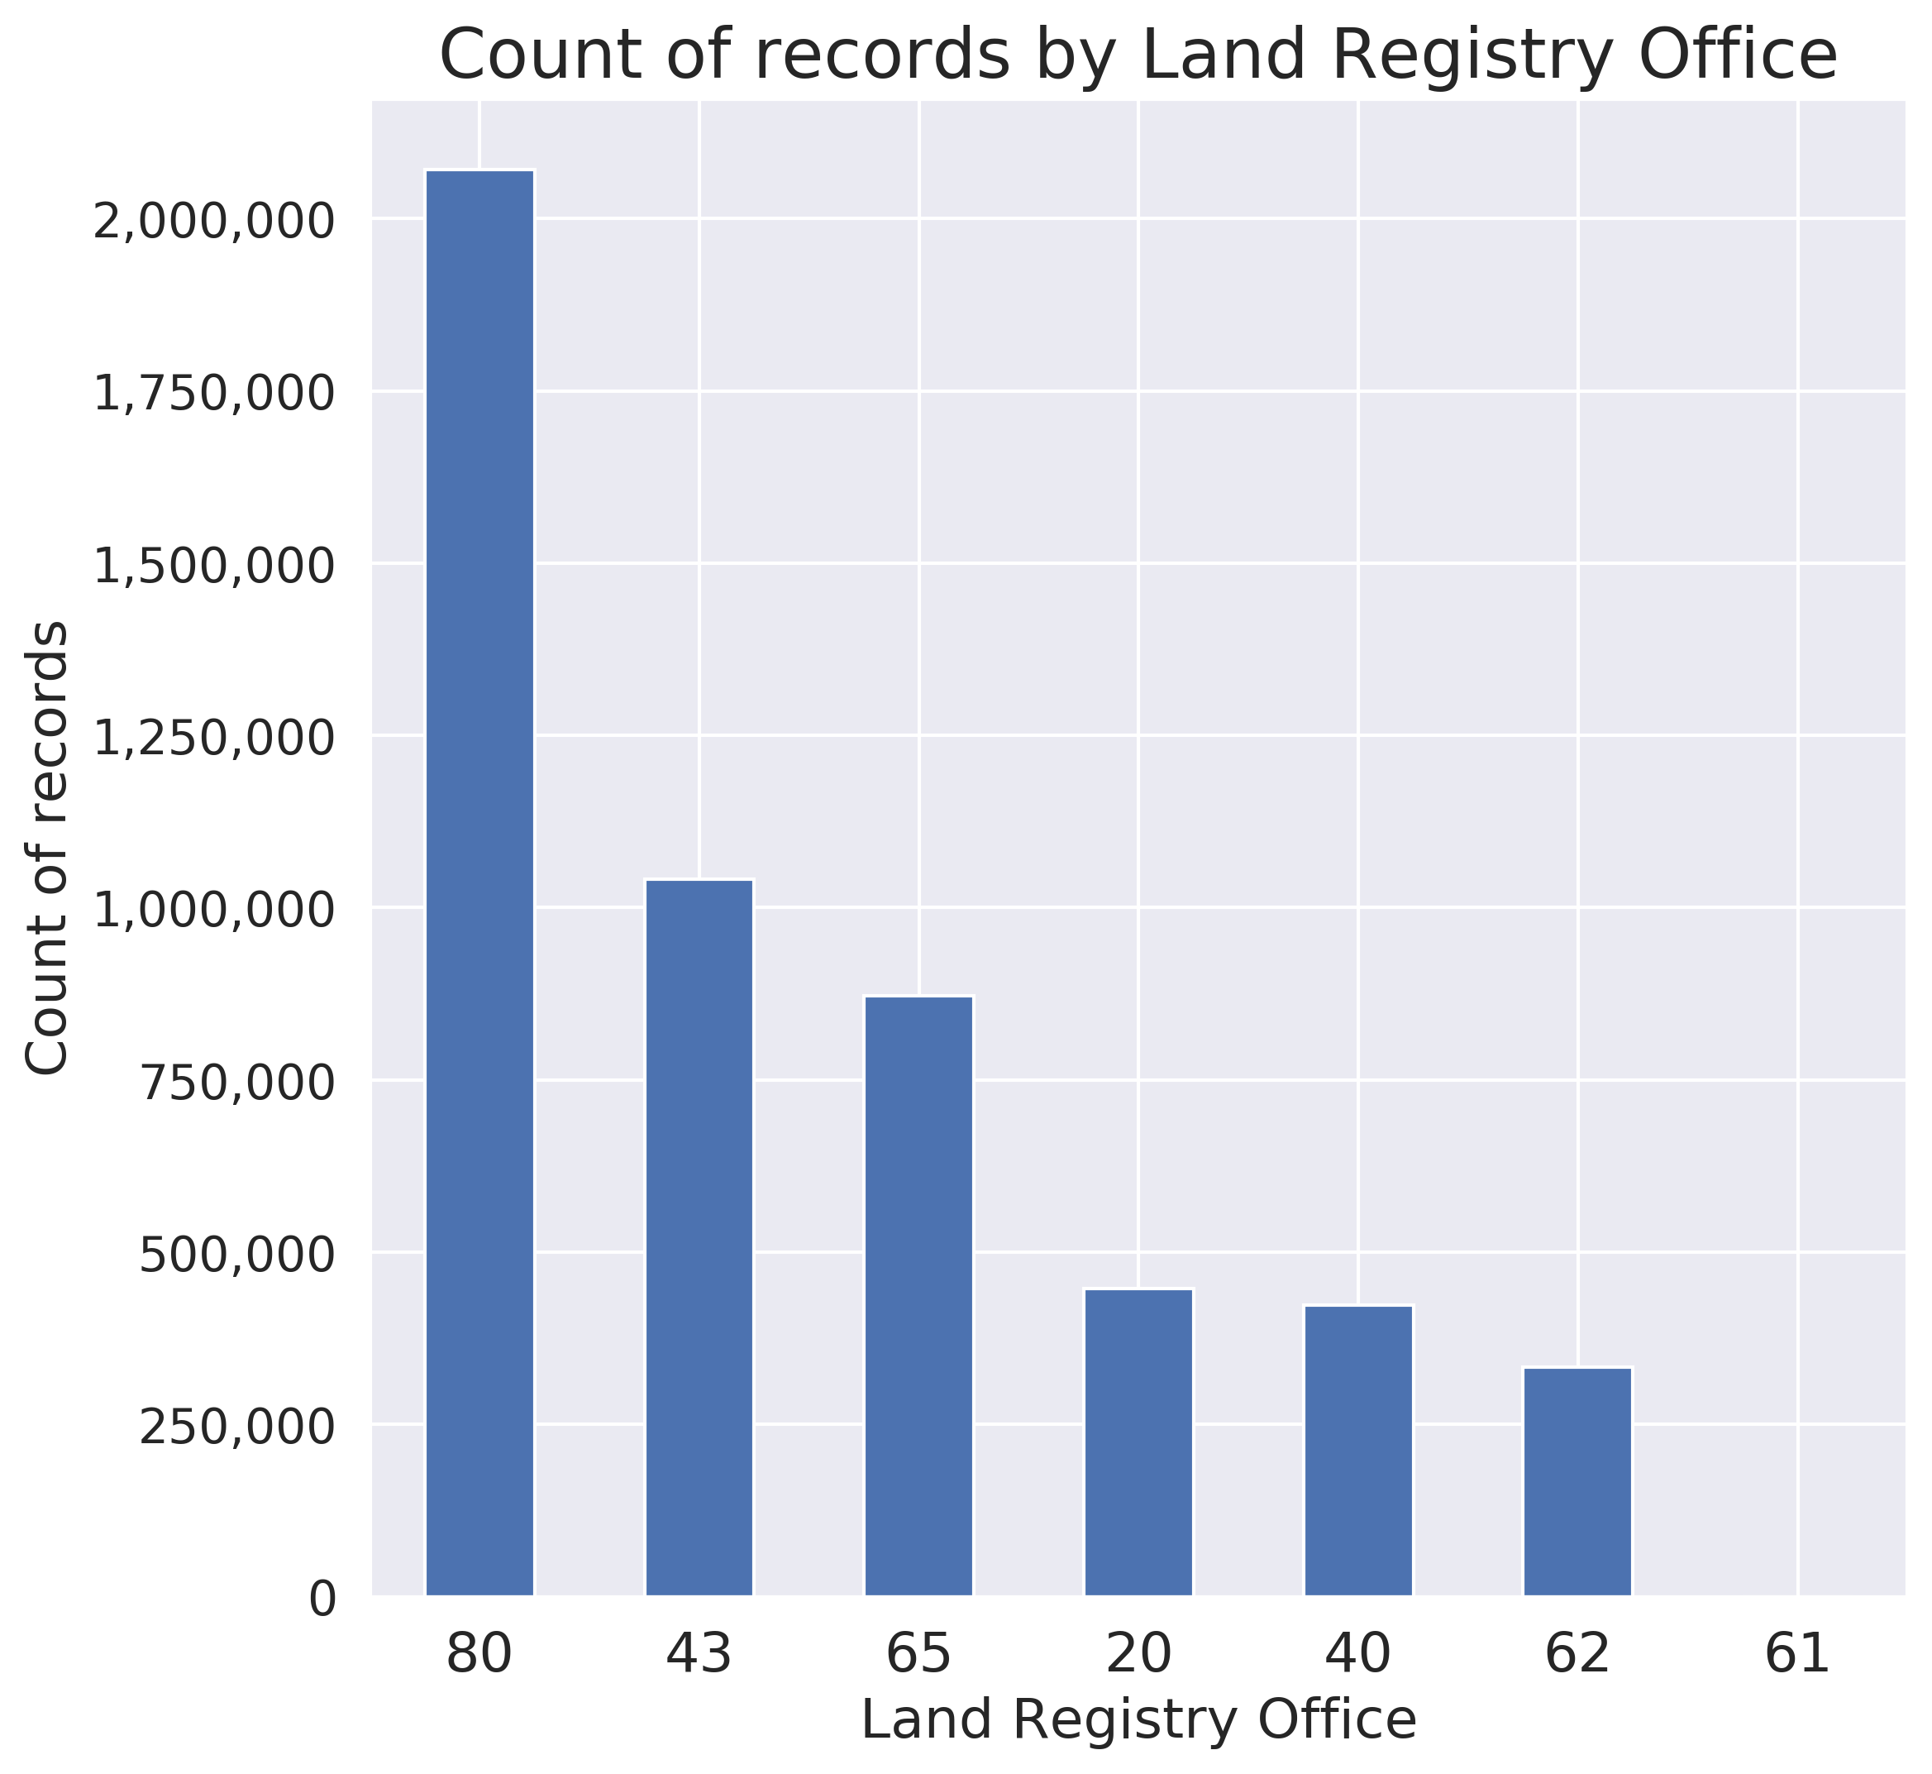
1.2: Distribution of count of records by LRO

Slide 9
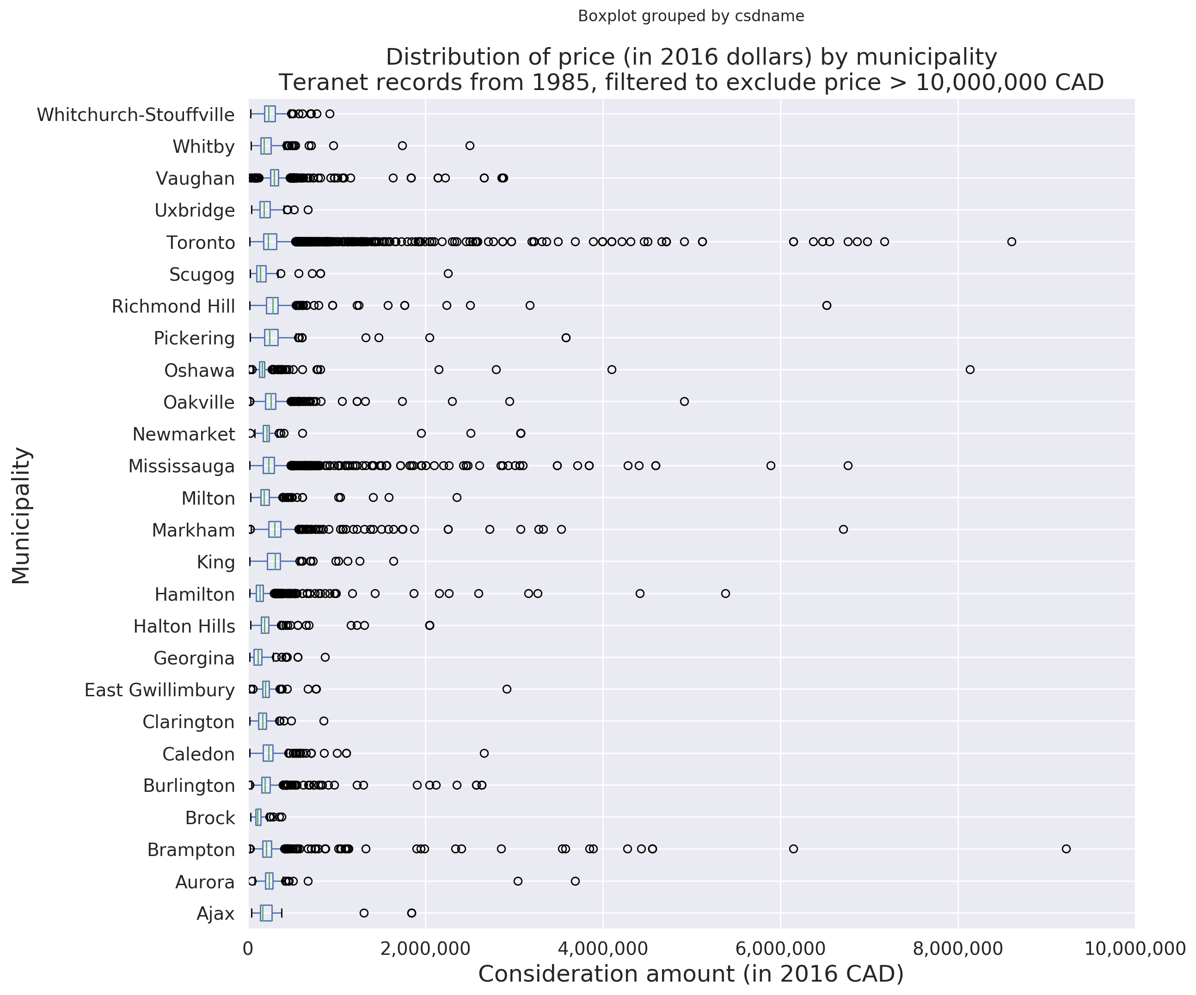

Slide 10
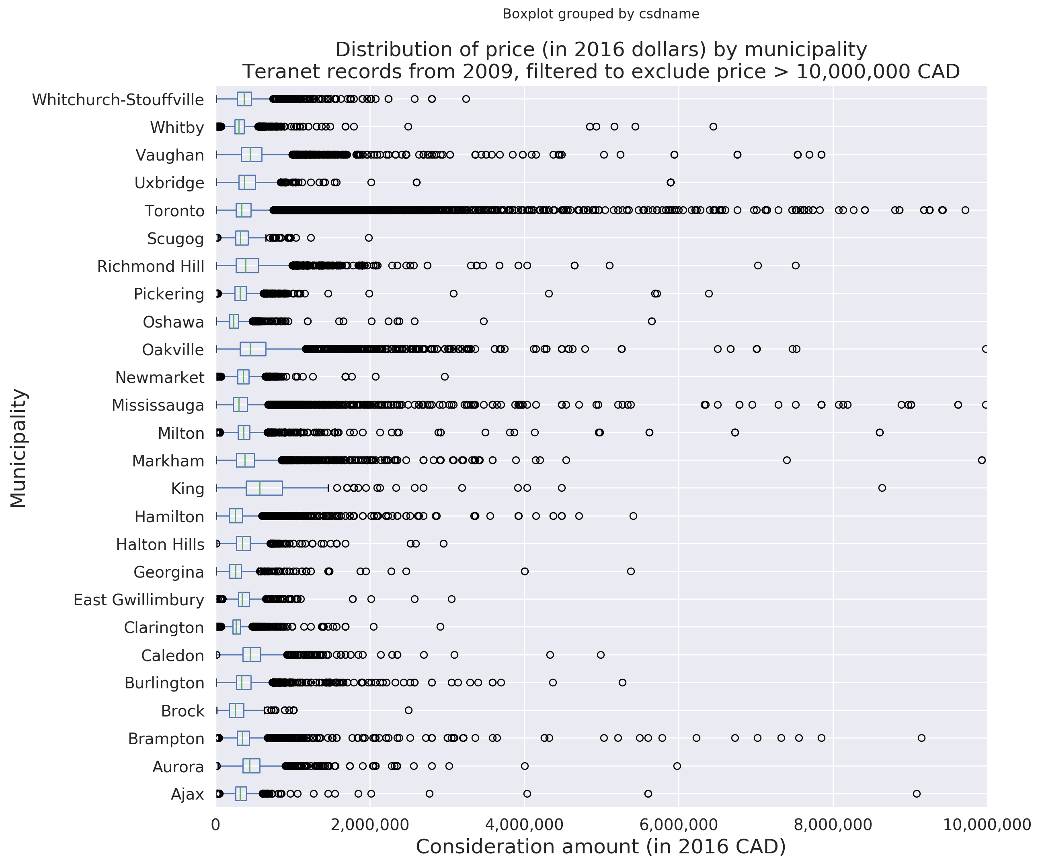

Slide 11
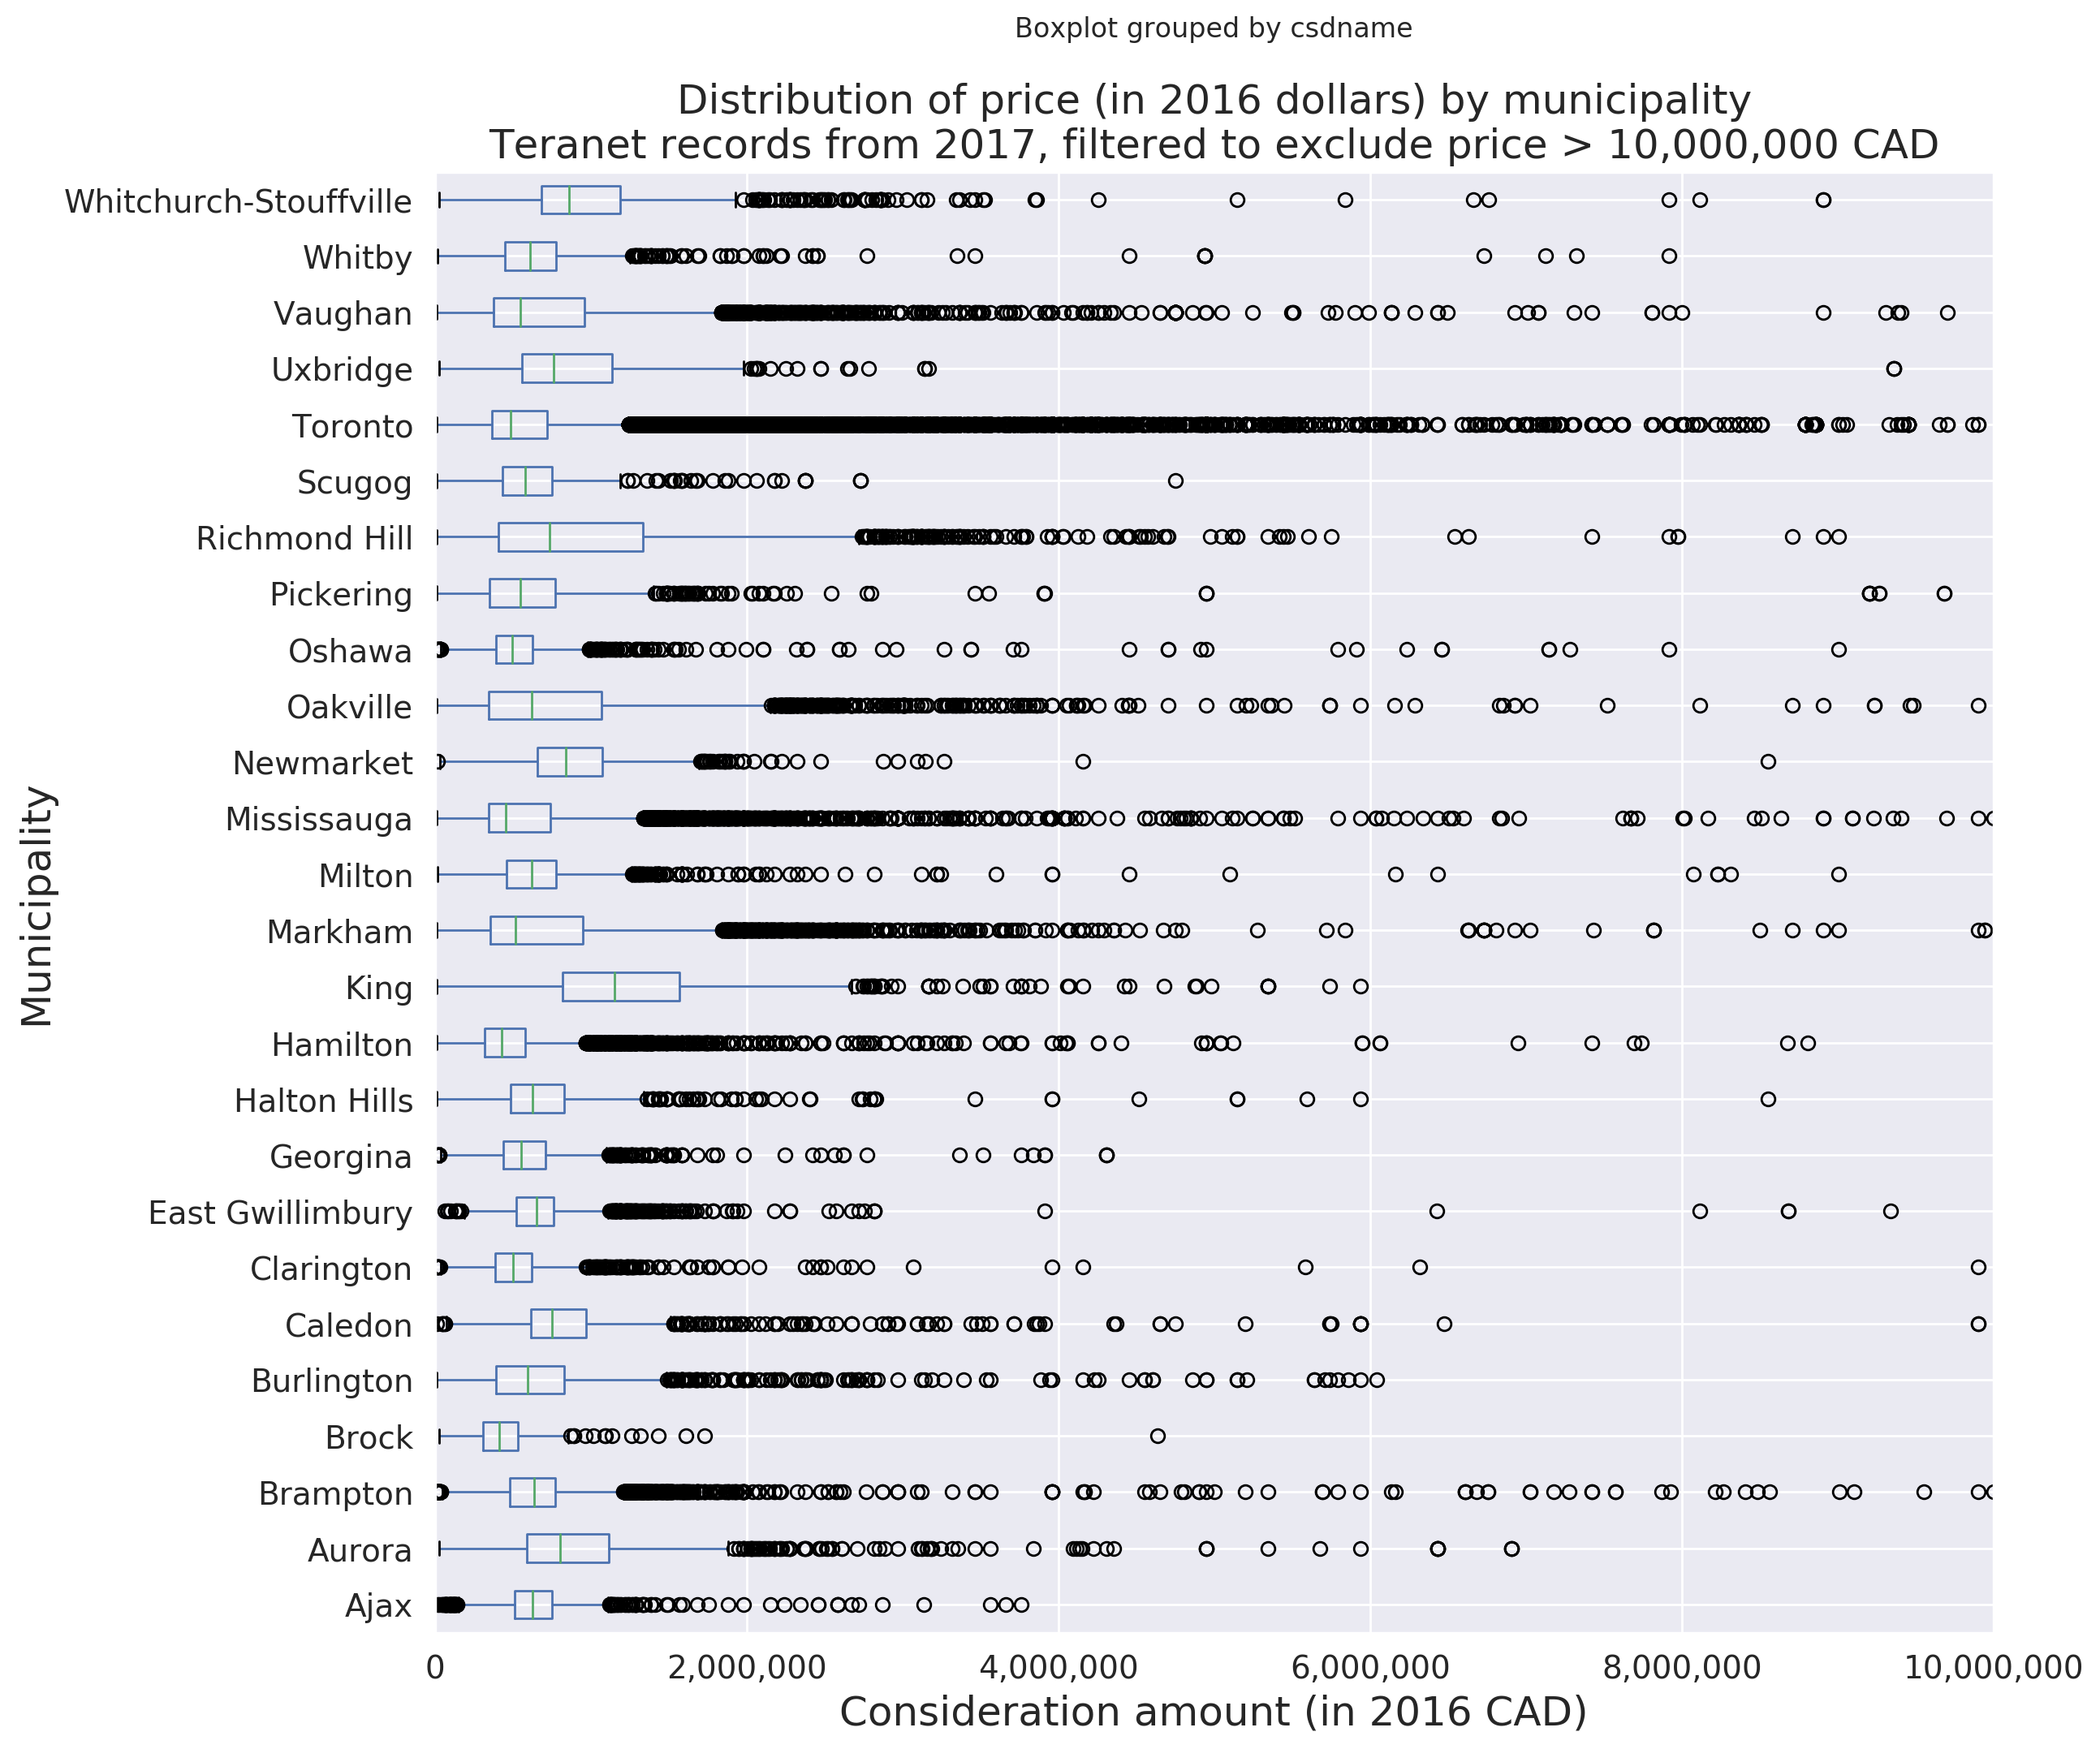

Slide 12
Section 2:
Large counts of records
by street name

Slide 13
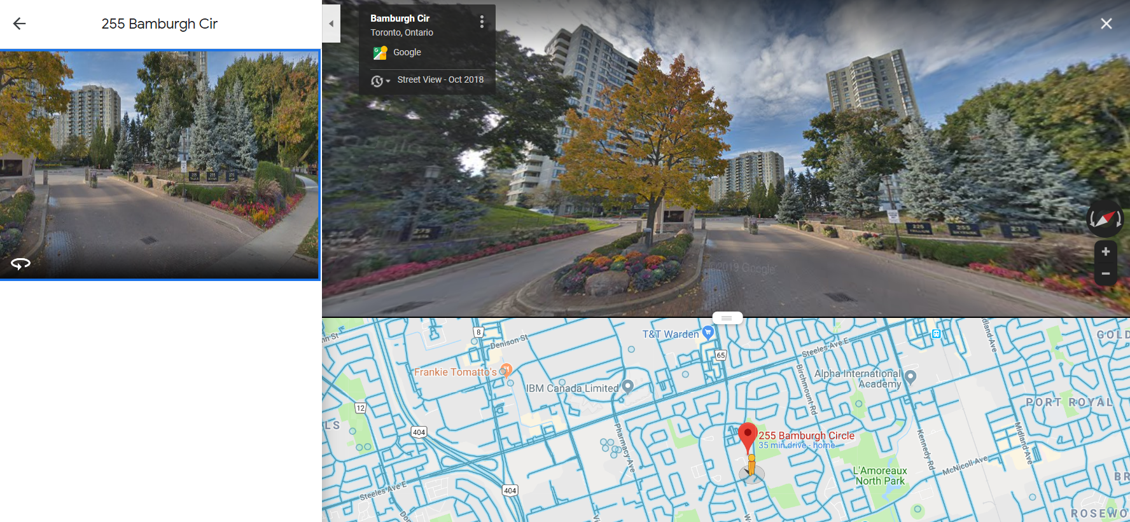
2.1: Bamburgh Cir, Scarborough

Slide 14
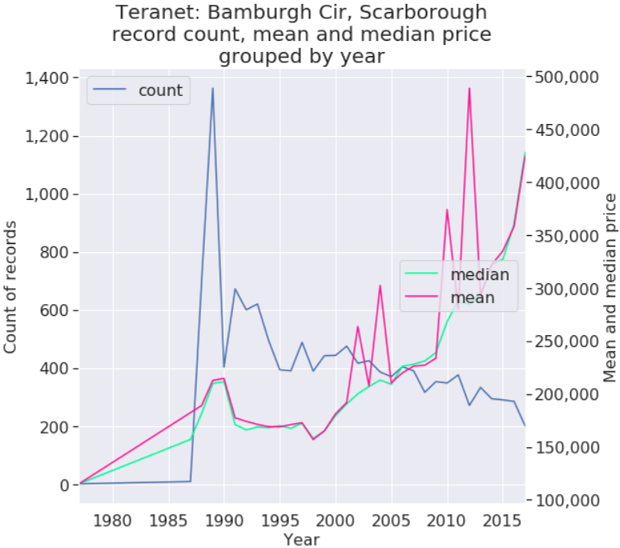
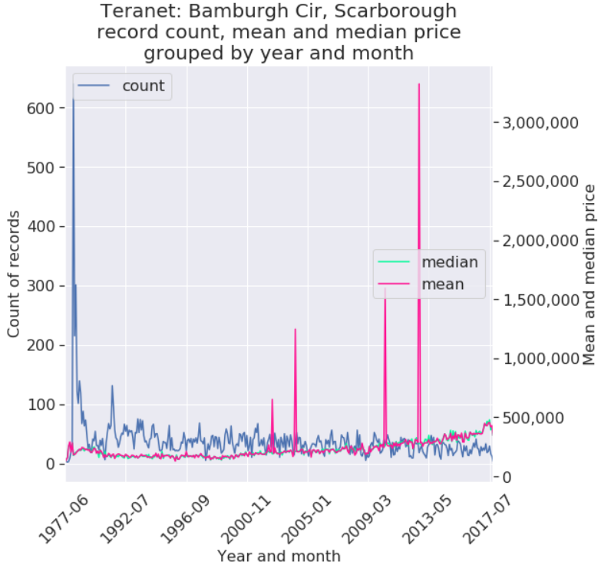
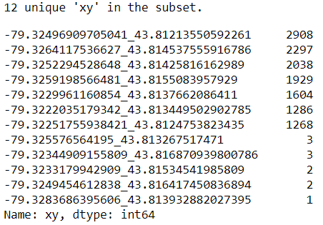
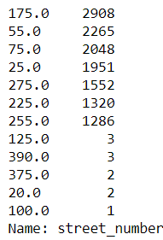
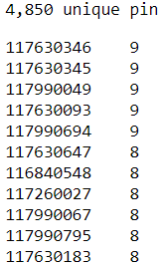
2.1: Bamburgh circle, Scarborough
Teranet record count
By street address:
By xy:
By pin:

Slide 15
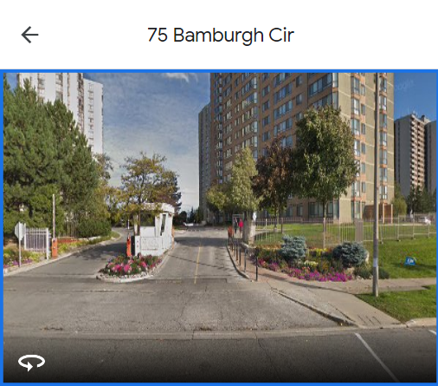
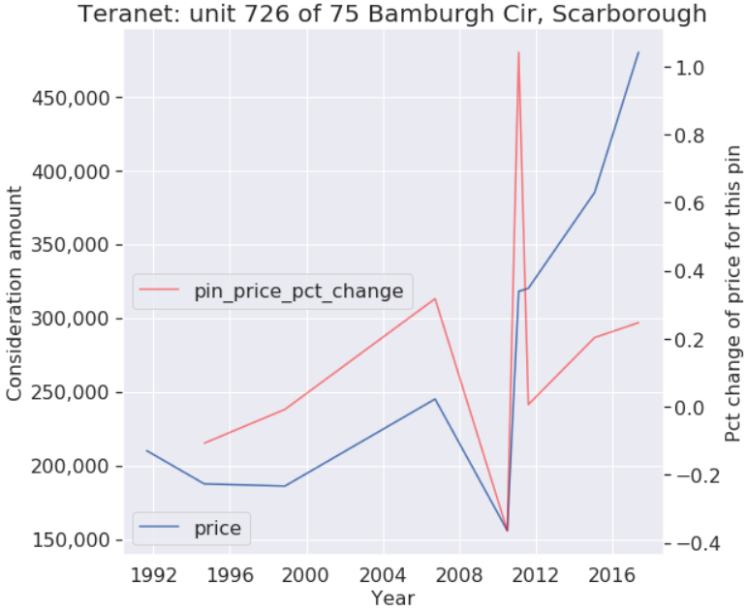
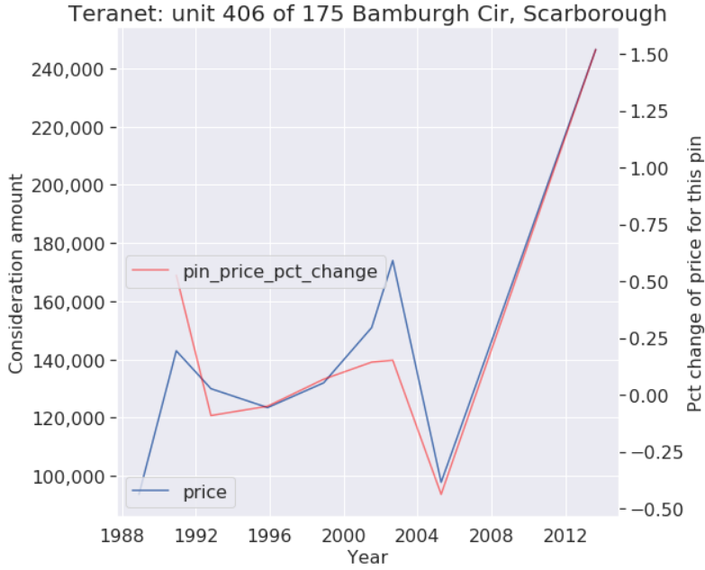
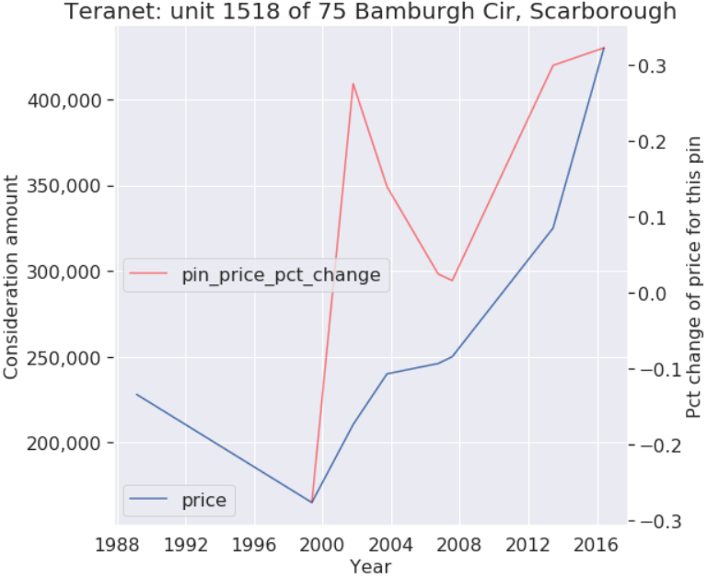
75 Bamburgh Cir, Scarborough individual unit sales

Slide 16
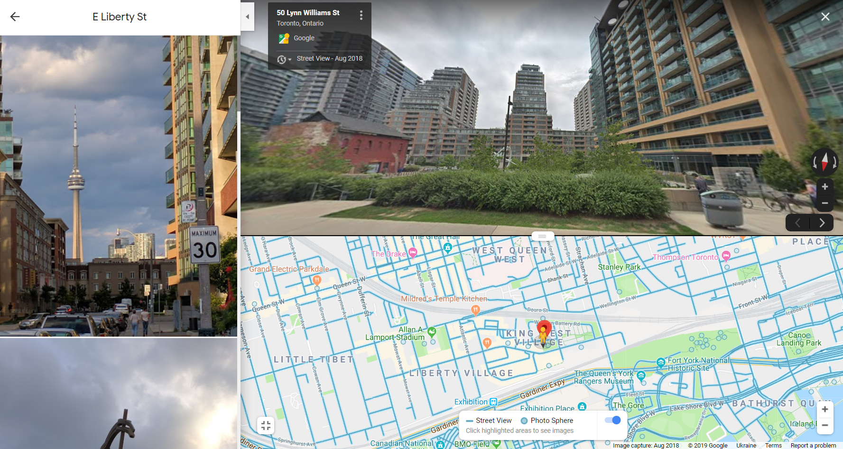
2.2: East Liberty St, Toronto

Slide 17
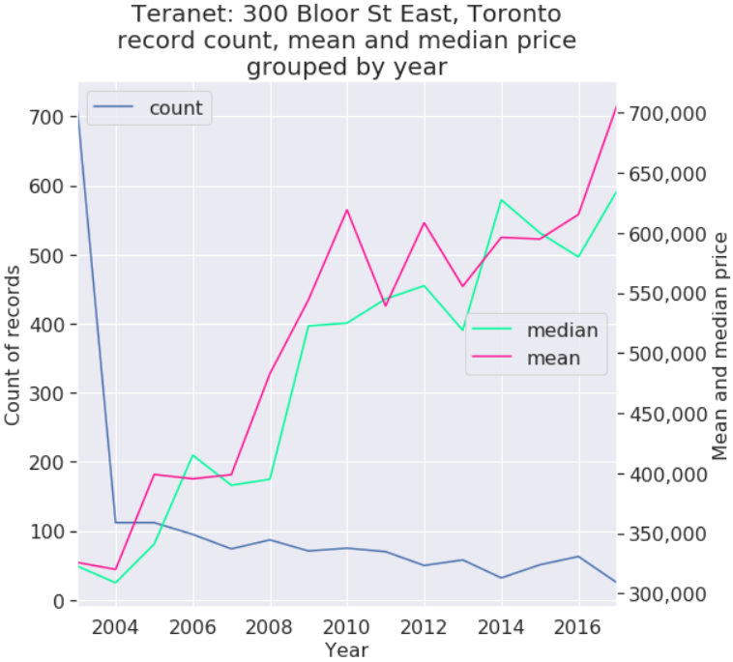
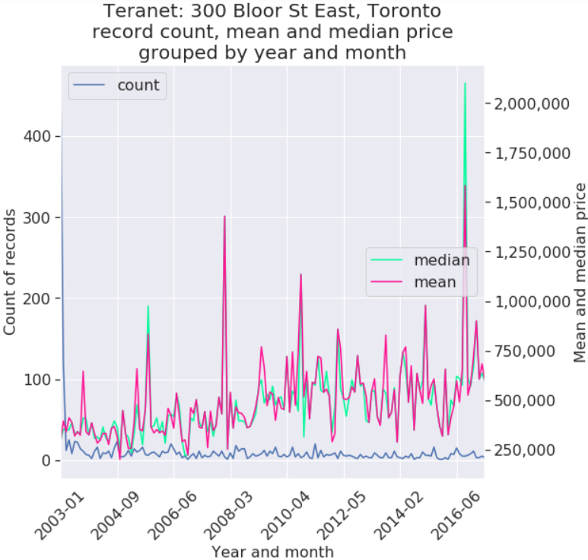
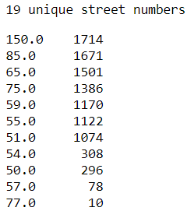
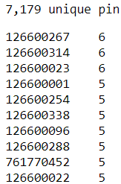
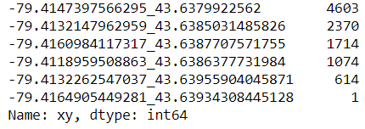
2.2: East Liberty St, Toronto
Teranet record count
By xy:
By street address:
By pin:

Slide 18
Section 3:
Large counts of records
by individual address

Slide 19
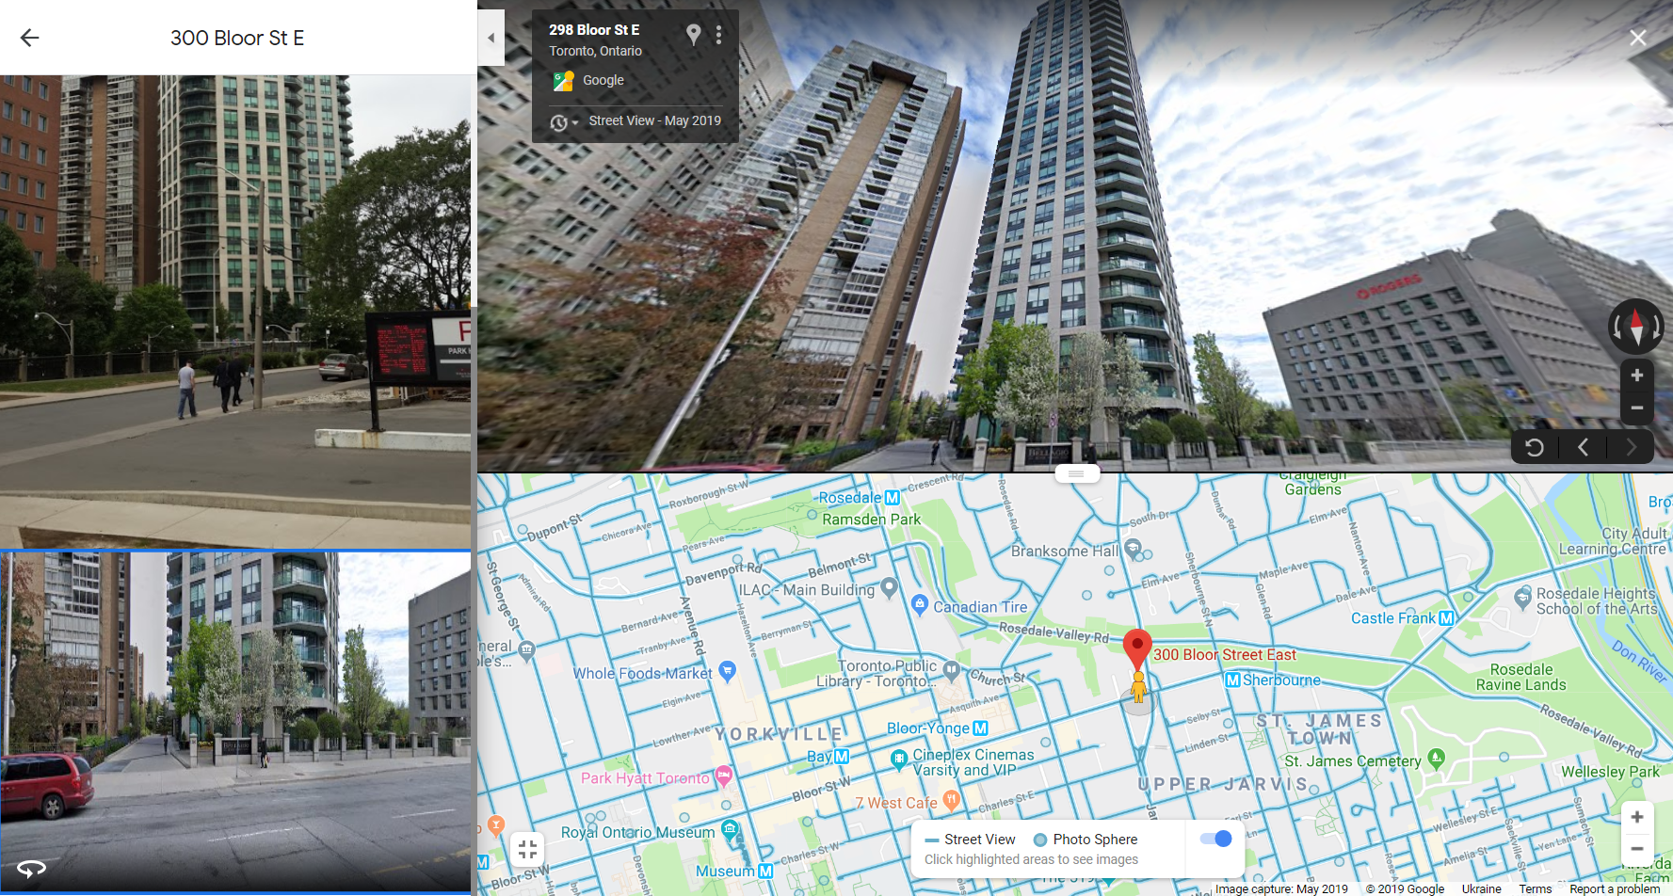
3.1: 300 Bloor St East, Toronto

Slide 20
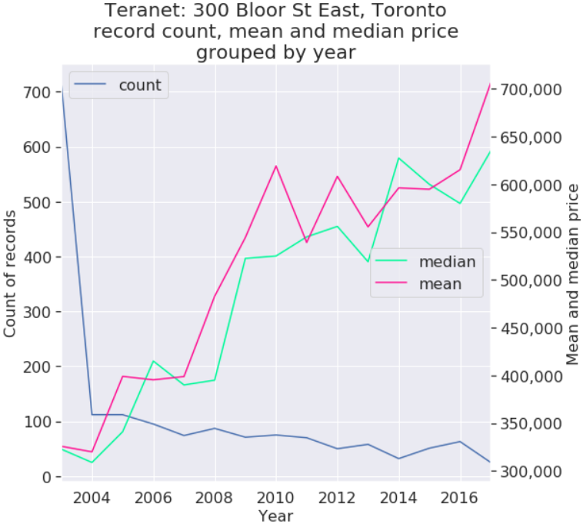
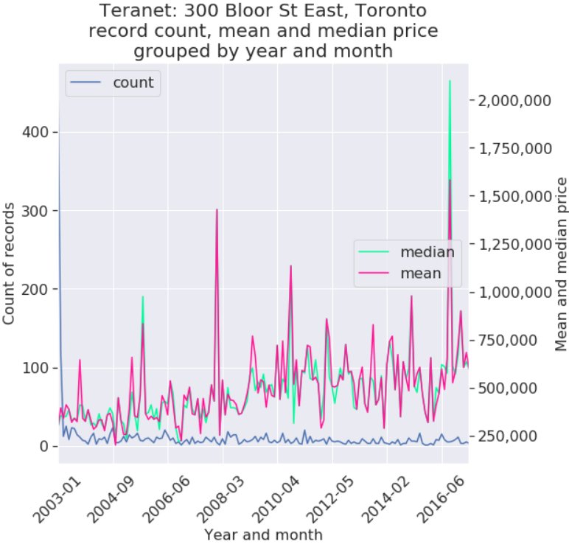
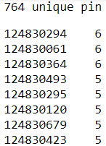
3.1: 300 Bloor St East, Toronto
Teranet record count
By pin:
By street address:
By xy:

Slide 21
Section 4:
Maps

Slide 22
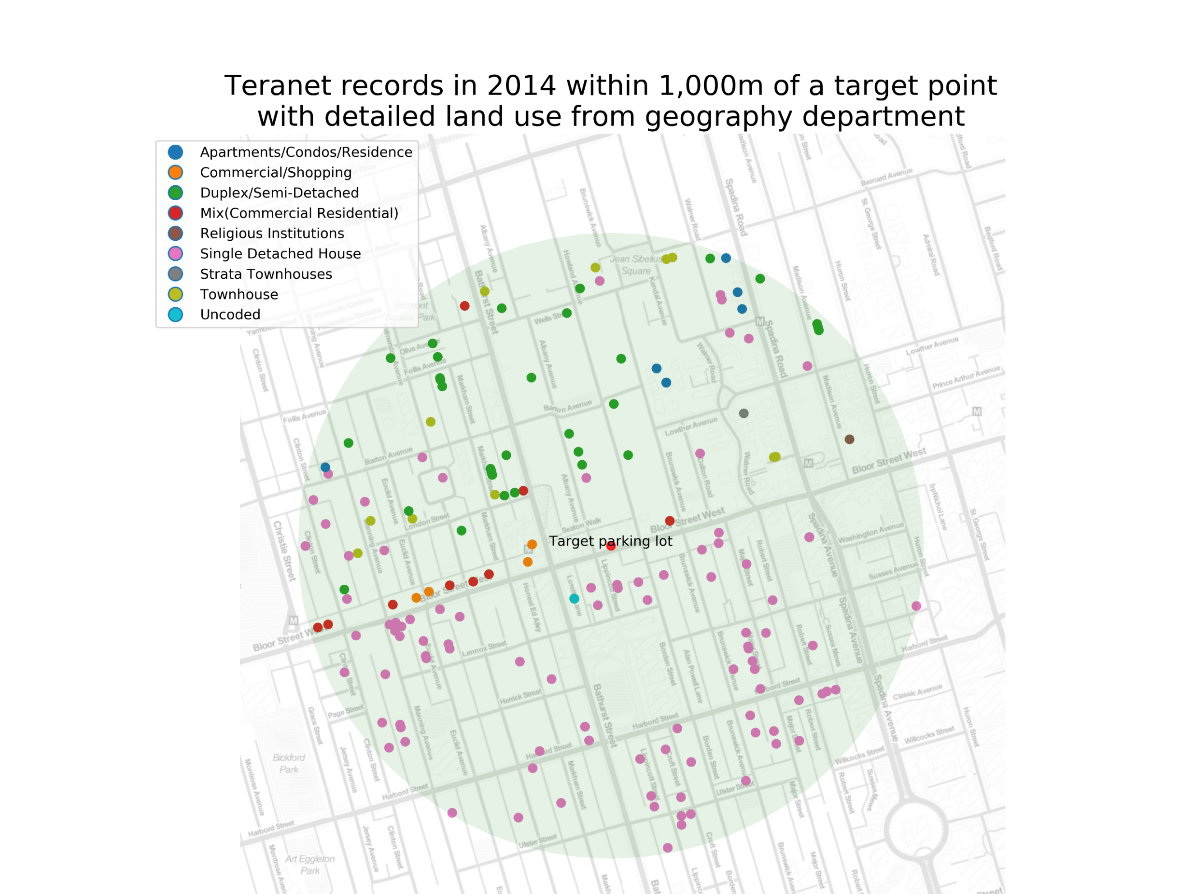
4.1 Teranet records within 1’000m of a point

Slide 23
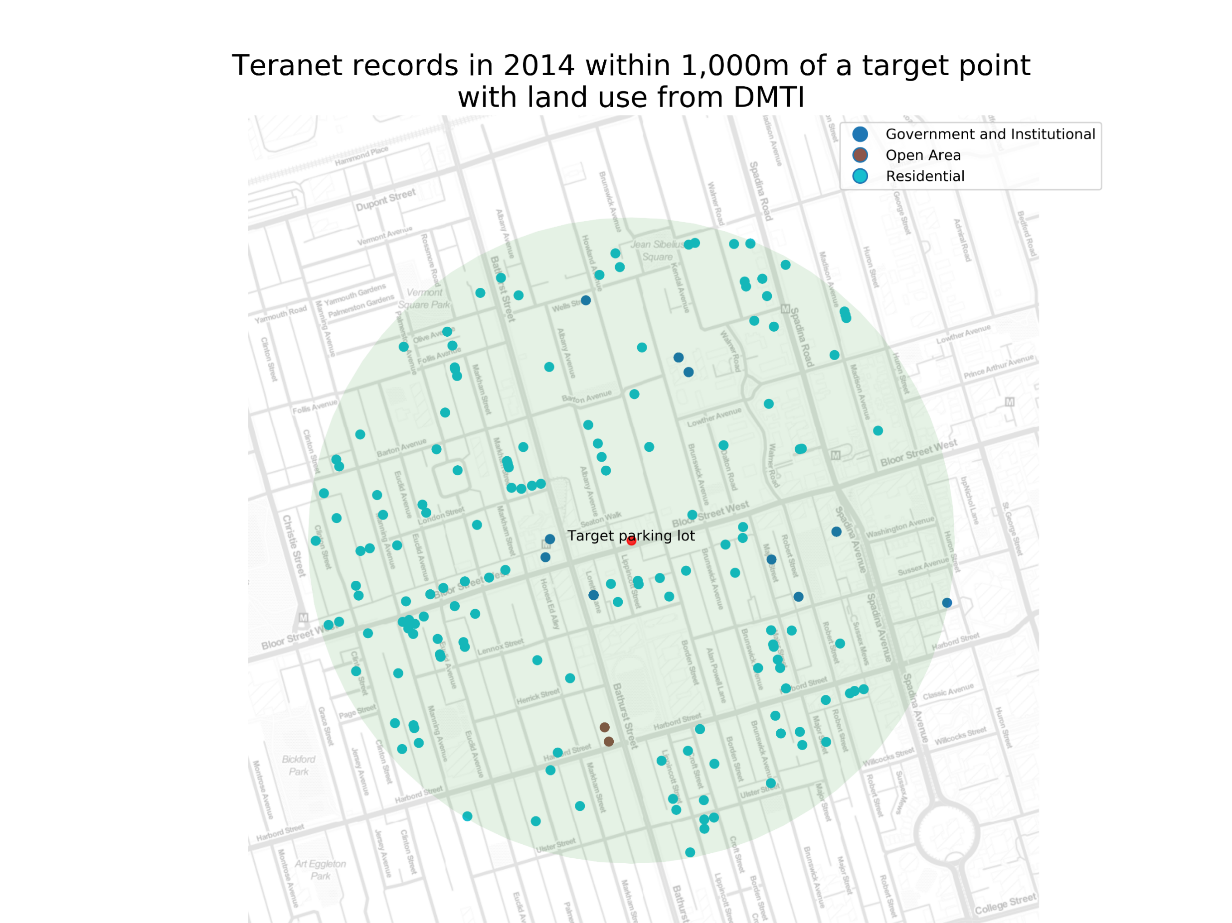
4.1 Teranet records within 1’000m of a point

Slide 24
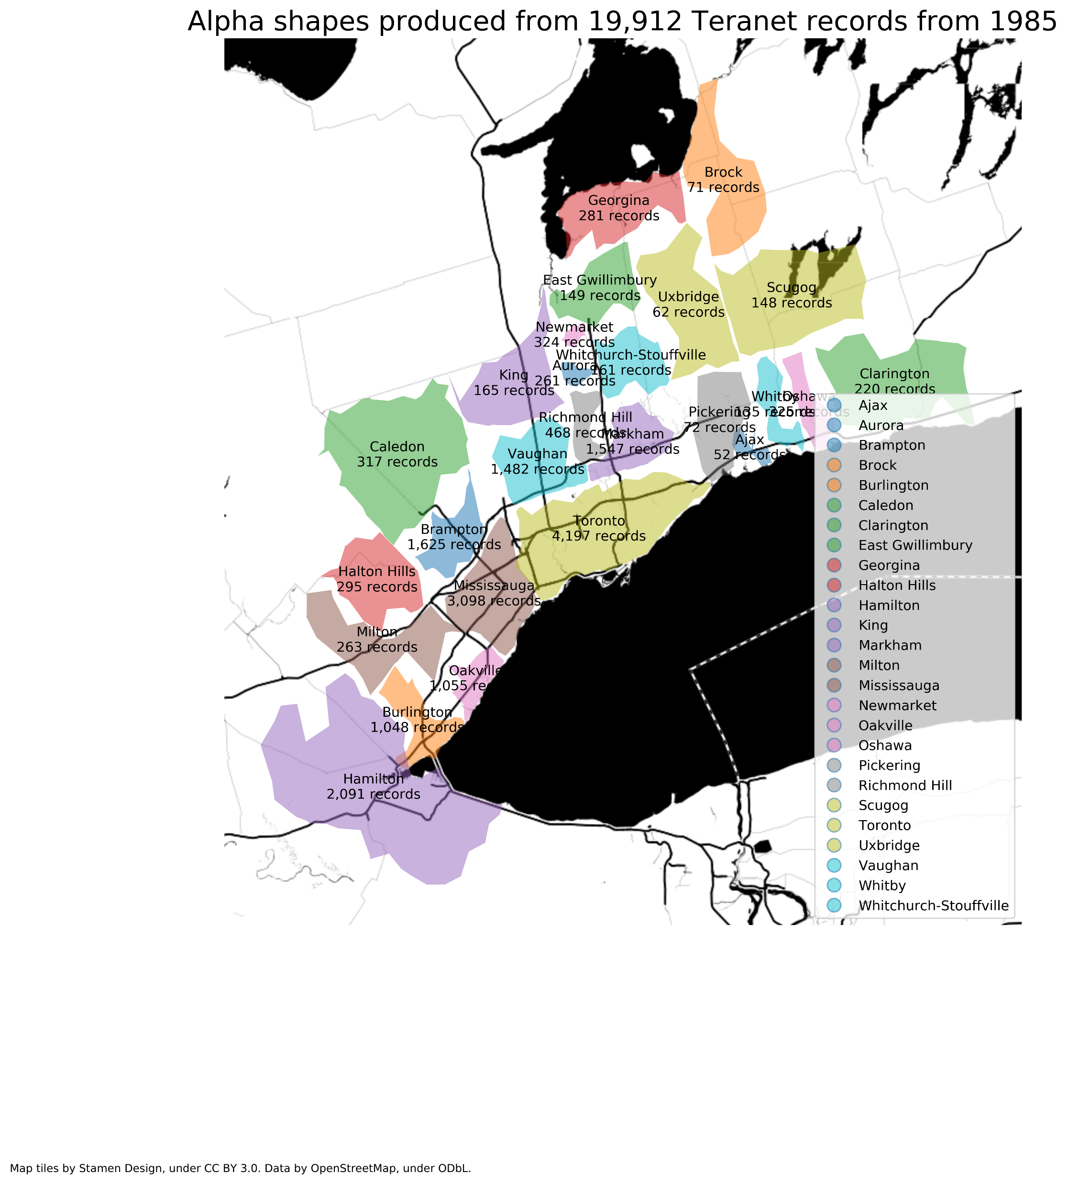
4.2 Alpha shapes of GTHA municipalities produced from Teranet records by year

Slide 25
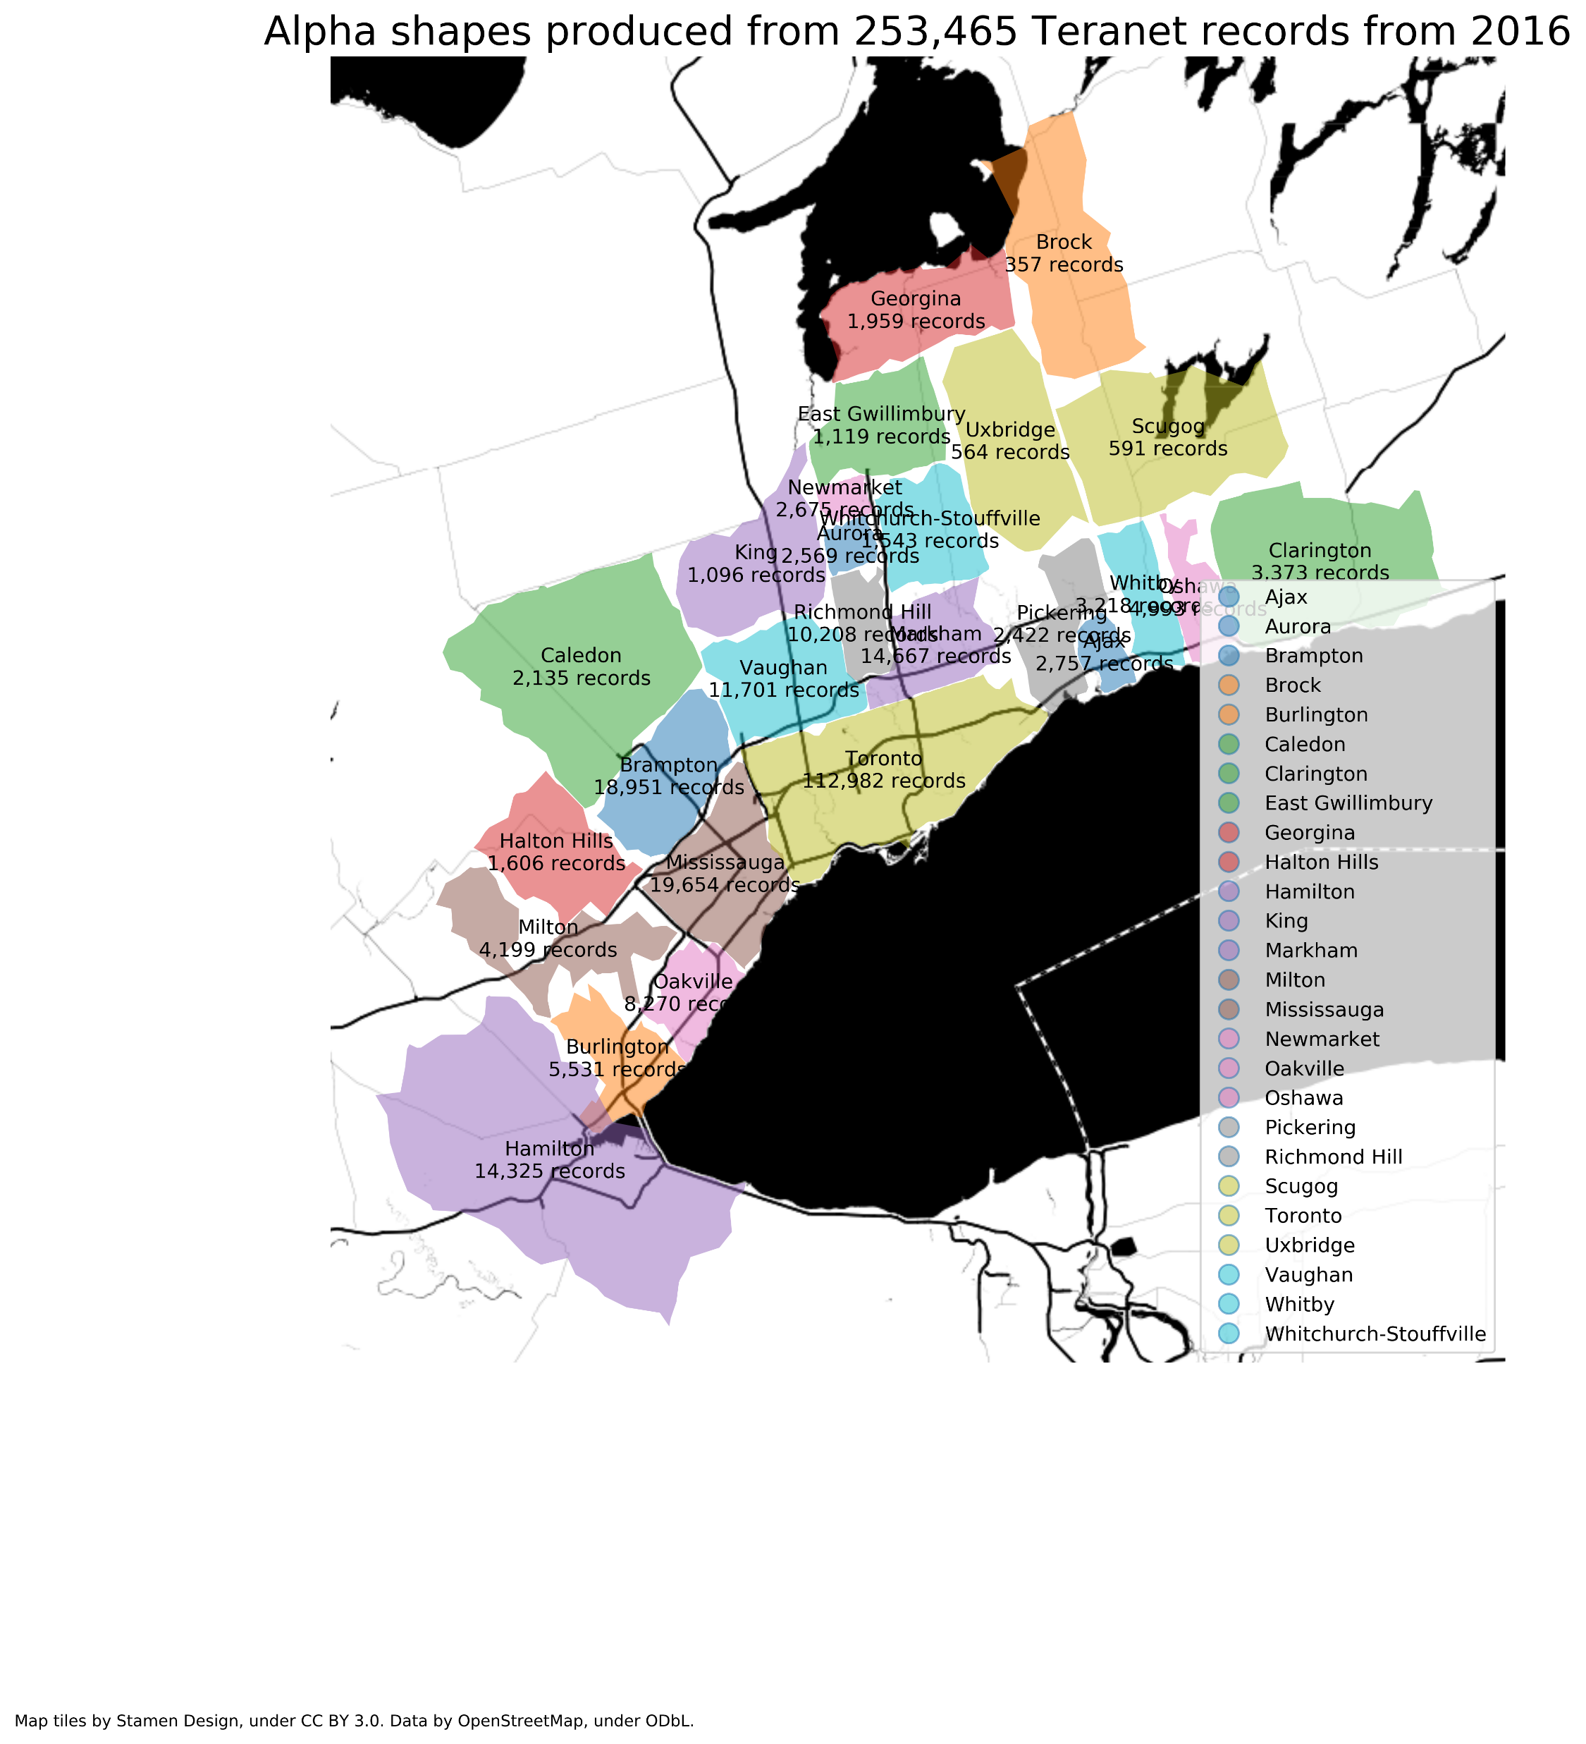
4.2 Alpha shapes of GTHA municipalities produced from Teranet records by year

Slide 26
Thesis chapters
Introduction
Background
complexity and “wicked” planning problems
land use and transportation
Land registration in Ontario
Challenges of working with Teranet data
Data sources, spatial, and temporal relationships
Data preparation
Database design
EDA
Conclusion

